Slide 1



Project Title
Smart Moisture Advisor (SMA)
An AI-driven irrigation advisory system for sugarcane
Members
Kartik Verma
Kushal Soni
Guide: Dr. Nilesh Yadav
Department of Computer Engineering 2026-27
Notes:
Students: Kartik Verma and Kushal Soni. Guide: Dr. Nilesh Yadav. Institution and department follow the supplied template and report/build_report.js. Project title follows README.md and package.json. No other student or guide attribution is retained.

Slide 2
Outline of Presentation
Introduction
Summary / Finding of Literature Survey
System Design & Architecture
Proposed Methodology and Implementation
Application Outputs
Results
Conclusion and Future Scope
References
Notes:
The template outline is retained in order. The original video section is replaced by actual application outputs, as requested. The demo is a separate deliverable.

Slide 3
Introduction
SMA supports sugarcane irrigation decisions for 1,000 plots in Mandya, Karnataka.
Plot vegetation, soil and climate inputs produce irrigation timing, water volume and pump duration.
The interface links rain-aware advice with fertigation, risk estimates, a map and pump scheduling.
Seven predictive models learn agronomy-generated labels. Field outcomes remain unverified.
Advisories support English, Kannada, Hindi and Marathi, with accept or override feedback.
Notes:
Sources: README.md, src/app.js, src/engine/advisory.js, src/engine/i18n.js, ml/train.py. Models estimate generated targets rather than measured field outcomes. Feedback is logged but not automatically used in training.

Slide 4
Summary / Finding of Literature Survey
Source | Approach or finding | Gap relative to SMA scope
Allen et al. [1] | FAO crop water balance and ET | Requires suitable local inputs and calibration
Doorenbos and Kassam [2] | Yield response to water deficit | Does not provide an integrated plot interface
Kamienski et al. [3] | SWAMP IoT platform and pilots | Deployment and scaling require infrastructure
Breiman [4] and Friedman [5] | Random Forest and Gradient Boosting | Require representative targets and evaluation
Current project [10] | Integrates advice, maps and scheduling | Independent field validation is still needed
The comparison identifies project requirements, without claiming superiority over the cited systems.
Notes:
[1] R. G. Allen, L. S. Pereira, D. Raes, and M. Smith, Crop Evapotranspiration: Guidelines for Computing Crop Water Requirements, FAO Irrigation and Drainage Paper 56. Rome: FAO, 1998. https://www.fao.org/4/x0490e/x0490e00.htm
[2] J. Doorenbos and A. H. Kassam, Yield Response to Water, FAO Irrigation and Drainage Paper 33. Rome: FAO, 1979. Bibliographic record: https://www.fao.org/4/y3655e/y3655e03.htm
[3] C. Kamienski et al., "Smart Water Management Platform: IoT-Based Precision Irrigation for Agriculture," Sensors, vol. 19, no. 2, article 276, 2019. doi: 10.3390/s19020276. https://www.mdpi.com/1424-8220/19/2/276
[4] L. Breiman, "Random forests," Machine Learning, vol. 45, pp. 5-32, 2001. doi: 10.1023/A:1010933404324. https://doi.org/10.1023/A:1010933404324
[5] J. H. Friedman, "Greedy function approximation: A gradient boosting machine," The Annals of Statistics, vol. 29, no. 5, pp. 1189-1232, 2001. doi: 10.1214/aos/1013203451. https://doi.org/10.1214/aos/1013203451
[6] F. Pedregosa et al., "Scikit-learn: Machine Learning in Python," Journal of Machine Learning Research, vol. 12, pp. 2825-2830, 2011. https://www.jmlr.org/papers/v12/pedregosa11a.html
Comparative gaps are scoped to this implementation. No head-to-head evaluation with SWAMP or other irrigation platforms was performed.

Slide 5
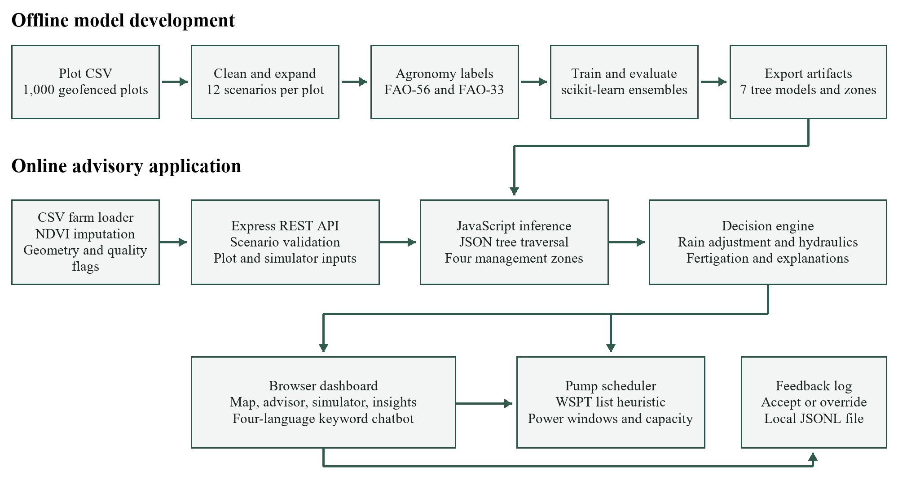
System Design & Architecture
Notes:
Architecture derived from ml/train.py, src/data/farms.js, src/ml/registry.js, src/ml/treeEnsemble.js, src/app.js and src/engine/. Offline training exports JSON. Runtime prediction occurs locally in Node.js. Feedback is appended to JSONL, not fed automatically into training.

Slide 6
Proposed Methodology and Implementation
Clean plot data and create twelve scenarios per plot.
Generate noisy FAO-based labels for irrigation, crop demand and risk.
Split by plot: 800 training plots and 200 held-out plots.
Train ensembles, compare linear or logistic baselines, then export JSON.
Serve predictions through Express and apply hydraulics, fertigation and scheduling rules.
1,000 plot records
12,000 generated scenarios
Grouped train / test evaluation
JSON model export
JavaScript advisory and scheduler
Notes:
Sources: ml/train.py and ml/agronomy.py. Label generation is supervised learning from a simulated agronomic teacher, not a physics-informed neural network. NDVI imputation currently precedes the grouped split. WSPT is a heuristic for parallel lanes and power windows, not a proof of optimal constrained scheduling.

Slide 7
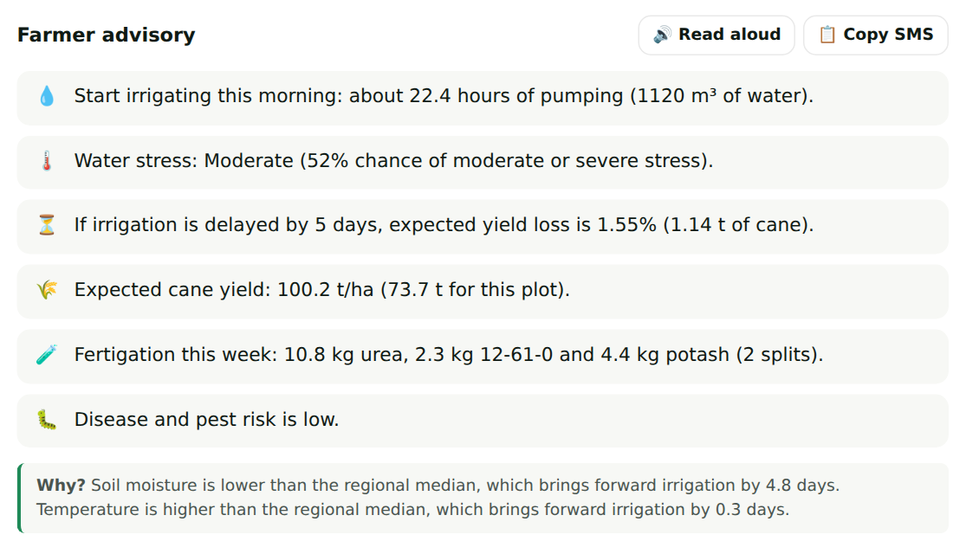
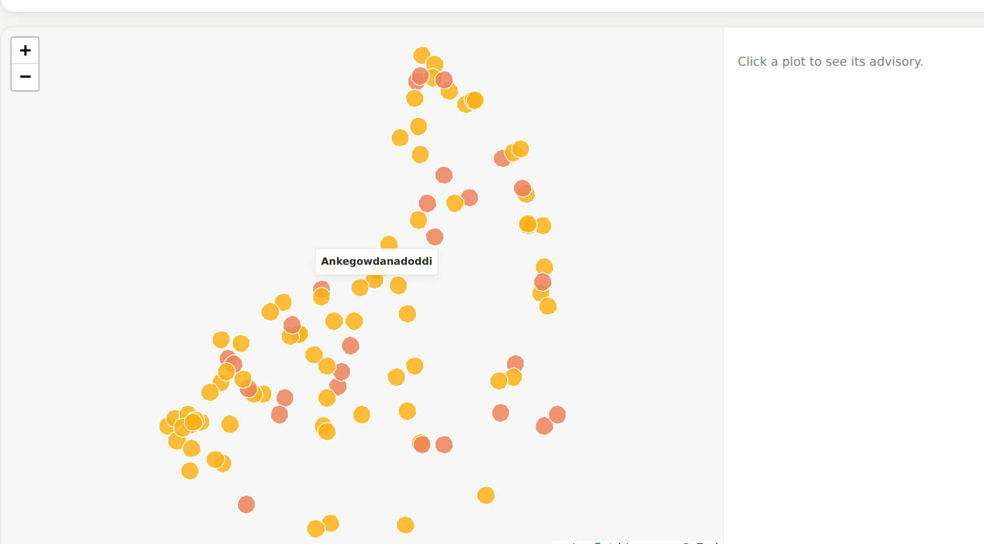
Application Outputs
Plot advice, yield, fertigation and risk
Geofenced plots coloured by stress
What-if Simulator recomputes outputs when field conditions change.
Krishi Mitra uses keyword intent detection in four supported languages.
Farmers and supervisors can accept or override the recommendation.
Notes:
Actual screenshot crops from presentation/screenshots/03_advisor.png and 02b_map_zoom.png. Example MM-MD-0110 is in the summer dry-spell scenario: 22.4 hours pumping, 1,120 cubic metres, 100.2 t/ha predicted yield, 1.55% predicted loss after a five-day delay. These values are scenario outputs, not measured farm outcomes. Capture date in the original screenshot: 30 September 2026. Chatbot: src/engine/chat.js.

Slide 8
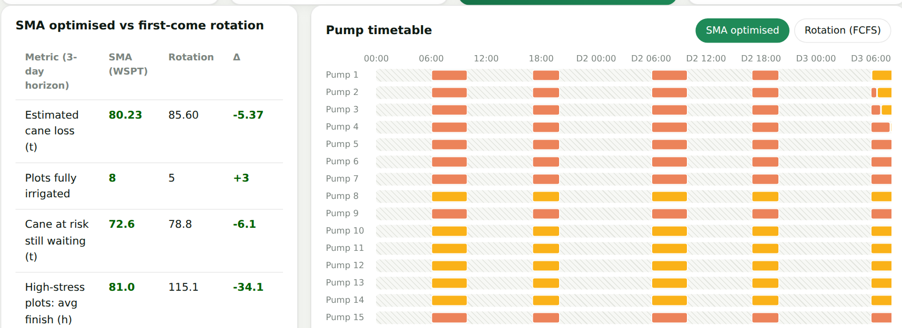
Results
Target | Ensemble score | Baseline score
Irrigation timing | 0.9646 | 0.7444
Crop water requirement | 0.9768 | 0.8843
Irrigation depth | 0.9745 | 0.6206
Cane yield | 0.8918 | 0.5709
Delay loss | 0.9755 | 0.4990
Water stress | 87.83% | 83.46%
Disease risk | 87.29% | 81.96%
Hosur schedule
8 plots completed vs 5
5.37 t less estimated loss
R-squared for regression, accuracy for classifiers. Timing MAE: 0.6942 days.
Evaluation uses generated labels on held-out plots. Savings and cane loss are scenario estimates.
Notes:
Source: models/metrics.json. Regression baselines are Linear Regression, classifiers use Logistic Regression. Timing baseline MAE 2.5796 days, ensemble 0.6942 days. Scheduler: report/data/results.json, schedule key, Hosur, 20 pumps, windows 06:00-10:00 and 17:00-20:00, three days. Optimised estimated cane loss 80.23 t, FCFS 85.60 t. Software tests: 23 passed on 19 October 2026. Results assess generated labels and scenario simulations, with no field trial.

Slide 9
Conclusion and Future Scope
SMA integrates plot-level prediction, irrigation advice and power-window scheduling in a working web prototype.
JSON model export supports local JavaScript inference. All 23 existing software tests pass.
The saved metrics show agreement with generated agronomic labels. Independent field validation is the main next step.
Future work: measured irrigation and yield records, verified weather feeds, actual planting dates and calibrated uncertainty.
Operational development: agronomist review, field pilots, role-based access and a reviewed retraining workflow.
Notes:
Sources: current source code, models/metrics.json, report/data/extra.json and execution of node --test test/api.test.js test/engine.test.js test/models.test.js. Live feed connectors, authenticated production operation and automatic feedback retraining are proposed work.

Slide 10
References
[1] Allen et al., Crop Evapotranspiration, FAO Paper 56, 1998. fao.org/4/x0490e/x0490e00.htm
[2] Doorenbos and Kassam, Yield Response to Water, FAO Paper 33, 1979.
[3] Kamienski et al., Smart Water Management Platform, Sensors 19(2), 276, 2019. doi:10.3390/s19020276
[4] Breiman, Random forests, Machine Learning 45, 5-32, 2001. doi:10.1023/A:1010933404324
[5] Friedman, A gradient boosting machine, Annals of Statistics 29(5), 1189-1232, 2001. doi:10.1214/aos/1013203451
[6] Pedregosa et al., Scikit-learn, JMLR 12, 2825-2830, 2011. jmlr.org/papers/v12/pedregosa11a.html
[10] Verma and Soni, Smart Moisture Advisor source and saved outputs. github.com/Interior-Gardener/SMA
Notes:
[1] R. G. Allen, L. S. Pereira, D. Raes, and M. Smith, Crop Evapotranspiration: Guidelines for Computing Crop Water Requirements, FAO Irrigation and Drainage Paper 56. Rome: FAO, 1998. https://www.fao.org/4/x0490e/x0490e00.htm
[2] J. Doorenbos and A. H. Kassam, Yield Response to Water, FAO Irrigation and Drainage Paper 33. Rome: FAO, 1979. Bibliographic record: https://www.fao.org/4/y3655e/y3655e03.htm
[3] C. Kamienski et al., "Smart Water Management Platform: IoT-Based Precision Irrigation for Agriculture," Sensors, vol. 19, no. 2, article 276, 2019. doi: 10.3390/s19020276. https://www.mdpi.com/1424-8220/19/2/276
[4] L. Breiman, "Random forests," Machine Learning, vol. 45, pp. 5-32, 2001. doi: 10.1023/A:1010933404324. https://doi.org/10.1023/A:1010933404324
[5] J. H. Friedman, "Greedy function approximation: A gradient boosting machine," The Annals of Statistics, vol. 29, no. 5, pp. 1189-1232, 2001. doi: 10.1214/aos/1013203451. https://doi.org/10.1214/aos/1013203451
[6] F. Pedregosa et al., "Scikit-learn: Machine Learning in Python," Journal of Machine Learning Research, vol. 12, pp. 2825-2830, 2011. https://www.jmlr.org/papers/v12/pedregosa11a.html
[7] Scikit-learn developers, "GroupShuffleSplit," official API documentation. https://scikit-learn.org/stable/modules/generated/sklearn.model_selection.GroupShuffleSplit.html
[8] Express contributors, "Express 5.x API," official documentation. https://expressjs.com/en/5x/api.html
[9] Leaflet contributors, "Leaflet API reference," official documentation. https://leafletjs.com/reference.html
[10] K. Verma and K. Soni, Smart Moisture Advisor, project implementation and repository artifacts, Interior-Gardener/SMA, local main checkout reviewed 19 October 2026. https://github.com/Interior-Gardener/SMA. Evidence: ml/train.py, ml/agronomy.py, src/, models/metrics.json, models/test_fixtures.json, report/data/results.json, report/data/extra.json, and presentation/screenshots/.

Slide 11
Thank You
Smart Moisture Advisor
Kartik Verma and Kushal Soni
Project Guide: Dr. Nilesh Yadav
Notes:
Closing slide follows the institution-branded template. The original chemistry-themed closing image has been replaced.

